Slide 1
End to End Encryption with SQL Server 2016
Steve Jones
SQLServerCentral
Red-gate Software

Slide 2
Agenda
Who am I?
Encryption Overview
Transparent Data Encryption (TDE)
Always Encrypted
Row Level Security (RLS)
Dynamic Data Masking (DDM)
Column Level Encryption
Summary

Slide 3




Who am I?
Steve Jones
SQLServerCentral founder
Redgate Software Evangelist
www.voiceofthedba.com
sjones@sqlservercentral.com
@way0utwest
/in/way0utwest

Slide 4
Encryption Overview
Use Wikipedia def

Slide 5
Encryption in SQL Server 2016
Diagram of hierarchy

Slide 6
Encryption Coverage
Client to server diagram

Slide 7
Transparent Data Encryption
Protect data at rest
Encrypts data and log files (mdf, ndf, ldf)
SQL Server 2008+ and Azure
Backup files encrypted
Tempdb encrypted

Slide 8
Demo
Transparent Data Encryption

Slide 9
Always Encrypted
Diagram

Slide 10
Demo
Always Encrypted

Slide 11
Row Level Security (RLS)
Allow rows of data to be screened based on user characteristics
Independent of other SQL Server security.
Available in SQL Server 2016+ and Azure SQL Database

Slide 12

OrderHeader table
OrderID | OrderAmount | SalespersonID
1001 | 5000.00 | 1
1002 | 1250.25 | 2
1003 | 922.13 | 2
1004 | 125.00 | 1
1005 | 4200.99 | 3
1006 | 1652.89 | 2
User Bob (SalespersonID 1
User sally (SalespersonID 2
Issue
query
Issue
query
Select * from OrderHeader
Select * from OrderHeader
Results
Results
OrderID | OrderAmount | SalespersonID
1001 | 5000.00 | 1
1004 | 125.00 | 1
OrderID | OrderAmount | SalespersonID
1002 | 1250.25 | 2
1003 | 922.13 | 2
1006 | 1652.89 | 2

Slide 13
Row Level Security
Security predicate function – Normal UDF created by administrator
SECURITY POLICY links a security predicate UDF to a table.

Slide 14
Demo
Row Level Security

Slide 15
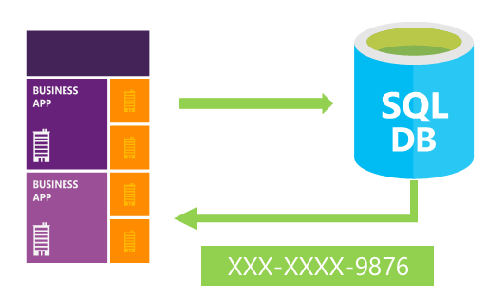
Dynamic Data Masking (DDM)
Notes:
Image:
https://blogs.technet.microsoft.com/dataplatforminsider/2016/01/25/use-dynamic-data-masking-to-obfuscate-your-sensitive-data/

Slide 16
Dynamic Data Masking (DDM)
No changes to data or storage
DDM defines how data appears when queried.
Does not require changes to application code
Notes:
Image:
https://blogs.technet.microsoft.com/dataplatforminsider/2016/01/25/use-dynamic-data-masking-to-obfuscate-your-sensitive-data/

Slide 17
Demo
Always Encrypted

Slide 18
Dynamic Data Masking - Limitations
Does not work with Always Encrypted columns.
UNMASK is by database, not by table or column.
Notes:
Image:
https://blogs.technet.microsoft.com/dataplatforminsider/2016/01/25/use-dynamic-data-masking-to-obfuscate-your-sensitive-data/

Slide 19
Column Level Encryption
Overview

Slide 20
Column Level Encryption – Limitations

Slide 21
Summary
SQL Server 2016 includes a variety of encryption functions for server and client

Slide 22
The End
Thank you for coming
Questions?
Ask at www.sqlservercentral.com/forums
www.voiceofthedba.com
sjones@sqlservercentral.com
@way0utwest
/in/way0utwest

Slide 23
References
DDM
Dynamic Data Masking (BOL) - https://msdn.microsoft.com/en-us/library/mt130841.aspx?f=255&MSPPError=-2147217396
https://blogs.technet.microsoft.com/dataplatforminsider/2016/01/25/use-dynamic-data-masking-to-obfuscate-your-sensitive-data/
A Very Quick Post on SQL Server 2016 Dynamic Data Masking - https://www.simple-talk.com/blogs/2015/06/10/a-very-quick-post-on-sql-server-2016-dynamic-data-masking/

